Slide 1
554 : Bloodstain Classification in Forensic Analysis Using Optimized 3D CNN
Md Al Amin Tokder [Presenting]
Department of Computer Science & Engineering
Rajshahi University Of Engineering & Technology
Tasmia Jannat
Department of Computer Science & Engineering
Rajshahi University Of Engineering & Technology
Md Ali Hossain
Department of Computer Science & Engineering
Rajshahi University Of Engineering & Technology
Nazmul Haque
Department of Computer Science & Engineering
Rajshahi University Of Engineering & Technology

Slide 2
Outline
Background / Motivation
Research Objectives
Methodology
Result and Analysis
Conclusion

Slide 3
Motivation
Hyperspectral image capture high information
Provide details information of an image
Remote sensing ,agriculture ,medicine, blood
Analysis of bloodstain patterns , forensic investigation
Crime scene analysis

Slide 4
Research Objective
To create a efficient method to identify substance classification in forensic science .
To get better accuracy
To capture both spectral and spatial information for analysis purpose
Dimensionality Reduction

Slide 5
Major Challenges
Identify substance classification in forensic science .
To create a efficient method
To get better accuracy
To capture both spectral and spatial information for analysis purpose
Dimensionality Reduction

Slide 6
Literature Review
Paper Title | Method Used | Limitation
“A Fast and 3D CNN for Hyperspectral Imaging-based Bloodstain Classification,” Forensic science international 2022 [1] | 1D,2D,3D Convolutional Neural Network | Accuracy = 95% Use PCA only for feature extraction
"Hyperspectral imaging for non-contact analysis of forensic traces,” Journal of Multidisciplinary Research at Trent 2019 [2] | Uses correlation coefficient in the visible region using reflectance spectroscopy to identify blood. | No use of Deep learning
“Blood stain classification with hyperspectral imaging and deep neural networks,” Science & Justice 2021 [3] | Multilayer Perceptron, Deep Recurrent Neural Network, | Use only one method (PCA) for feature extraction

Slide 7
Problem Statement
Need Efficient feature extraction technique
Need a custom model for better accuracy
Forensic investigations heavily rely on the identification and classification of bloodstains
Traditional methods for bloodstain analysis in forensic science face limitations in terms of accuracy and efficiency.

Slide 8
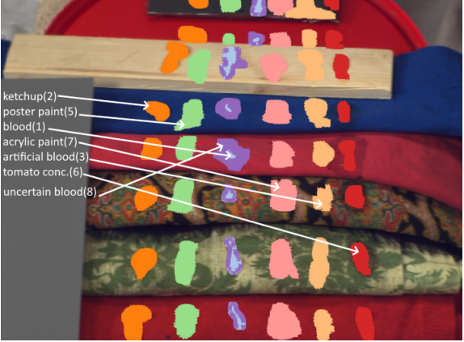
Dataset Description
The dataset is called “Hyperblood“ Hyperspectral-based Bloodstain dataset.
This dataset has different types of substances i.e., blood and blood-like compounds, for instance, ketchup, artificial blood, beetroot juice, poster paint, tomato concentrate, acrylic paint, uncertain blood.[1]
Source : www.kaggle.com
Fig-1: Hyperblood dataset

Slide 9
Dataset Description
Dataset contains : 14 hyperspectral images (ENVI format)
Image size : 519 x 696 pixels (each pixel contains 113 band)
Number of Class : 7
# of Dimensions : 15
Shape of HSI (519, 696, 113)
Shape of GT (519, 696)
Name of Classes [0 1 2 3 4 5 6 7]
Source : www.kaggle.com

Slide 10
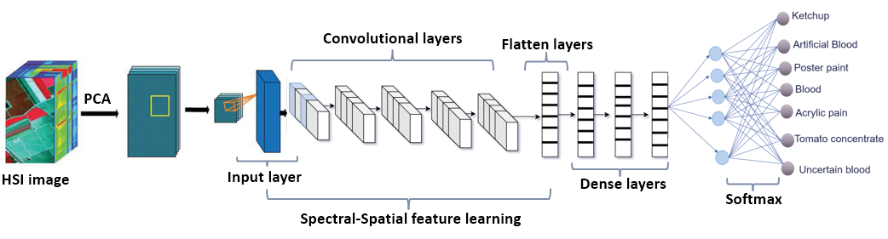
Proposed Methodology
Figure-2 : Proposed 3D CNN

Slide 11
Dataset Preprocessing
Before PCA | After Applying PCA
Shape of HSI (519, 696, 113) | Create Image Cubes for Model Building Shape of HSI (33804, 9, 9, 15)
Shape of GT (519, 696) | Shape of GT (33804)

Slide 12
Train Test and Validation Sets
Training (1690, 9, 9, 15, 1)
Validation (1690, 9, 9, 15, 1)
Test (30424, 9, 9, 15, 1)
Ratio of Train, Validation and Test is : 5% : 5%: 90%

Slide 13
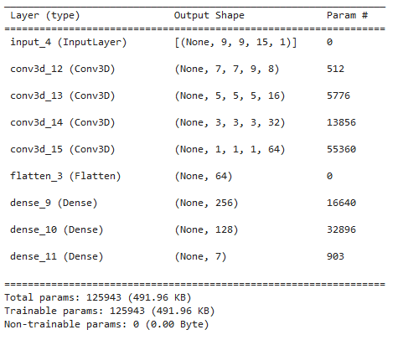
Proposed 3D CNN [1]
Number of Layers :
Convolution Layer: 4
Flatten layer:1
Dense layer:2
Output layer 1
Activation Function uses in layers:
Convolution Layer: Mish
Dense layer: Mish
Output layer : Softmax
Figure-3: Modified 3D CNN Model [1]

Slide 14
Existing vs Proposed Methodology
Existing 3D CNN | Optimized 3D CNN
Number of Layers : Convolution Layer: 4 Flatten layer: 1 Dense layer: 2 Output layer : 1 | Number of Layers : Convolution Layer: 3 Flatten layer: 1 Dense layer: 3 Output layer : 1
Activation Function uses in layers: Convolution Layer: Relu Dense layer: Relu Output layer : Softmax | Activation Function uses in layers: Convolution Layer: Mish Dense layer: Mish Output layer : Softmax
Accuracy: 95% | Accuracy: 97%

Slide 15
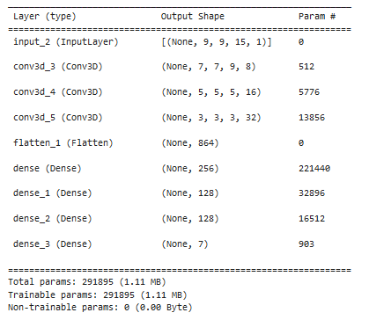
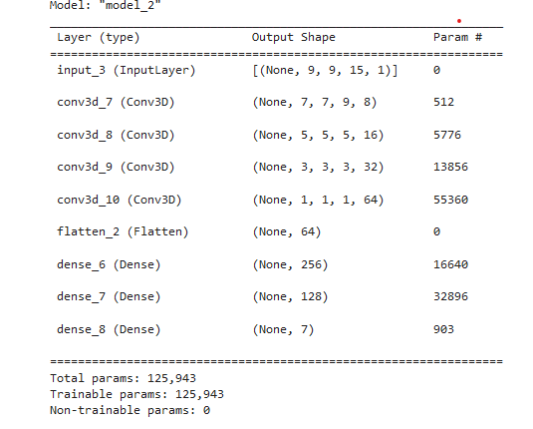
Existing 3D CNN | Proposed 3D CNN

Slide 16
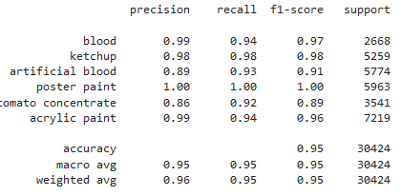
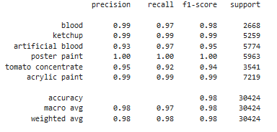
Existing 3D CNN (Result) | Proposed 3D CNN (Result)

Slide 17
Classifier Performance
Classifiers | Accuracy | Macro avg | Weighted avg | Parameter
3D CNN | 0.95 | 0.95 | 0.95 | 291895
Optimized 3D CNN | 0.97 | 0.96 | 0.97 | 125943

Slide 18
Classification Result (Existing Vs Proposed)
Type | Precision Exist Prop |  | Recall Exist Prop |  | F1-score Exist Prop |  | Support Exist Prop
Blood | 0.99 | 0.99 | 0.94 | 0.97 | 0.97 | 0.98 | 2668 | 2668
KetChup | 0.98 | 0.99 | 0.98 | 0.99 | 0.98 | 0.99 | 5259 | 5259
Artificial blood | 0.89 | 0.93 | 0.93 | 0.97 | 0.91 | 0.95 | 5774 | 5774
Poster paint | 1.00 | 1.00 | 1.00 | 1.00 | 1.00 | 1.00 | 5963 | 5963
Tomato concentrate | 0.86 | 0.95 | 0.92 | 0.92 | 0.89 | 0.94 | 3541 | 3541
Acrylic paint | 0.99 | 0.99 | 0.94 | 0.99 | 0.96 | 0.99 | 7219 | 7219
Accuracy |  |  |  |  | 0.95 | 0.97 | 30424 | 30424
Macro avg | 0.95 | 0.98 | 0.95 | 0.97 | 0.95 | 0.98 | 30424 | 30424
Weighted avg | 0.96 | 0.98 | 0.95 | 0.98 | 0.95 | 0.98 | 30424 | 30424

Slide 19
Relu Vs Mish Activation Function
Activation Function | Relu (Existing 3D CNN ) |  | Mish (Proposed 3D CNN)
Epochs Number | Training Accuracy | Validation Accuracy | Training Accuracy | Validation Accuracy
1 | 0.3361 | 0.6373 | 0.4917 | 0.5793
2 | 0.3876 | 0.8479 | 0.6414 | 0.6976
3 | 0.3767 | 0.9136 | 0.7586 | 0.8343
4 | 0.9112 | 0.9219 | 0.8710 | 0.8982
5 | 0.9272 | 0.9414 | 0.9077 | 0.9260
6 | 0.9473 | 0.9349 | 0.9337 | 0.9379
7 | 0.9574 | 0.9355 | 0.9432 | 0.9550
8 | 0.9568 | 0.9562 | 0.9556 | 0.9592
9 | 0.9728 | 0.9627 | 0.9556 | 0.9592
10 | 0.9746 | 0.9621 | 0.9722 | 0.9669

Slide 20
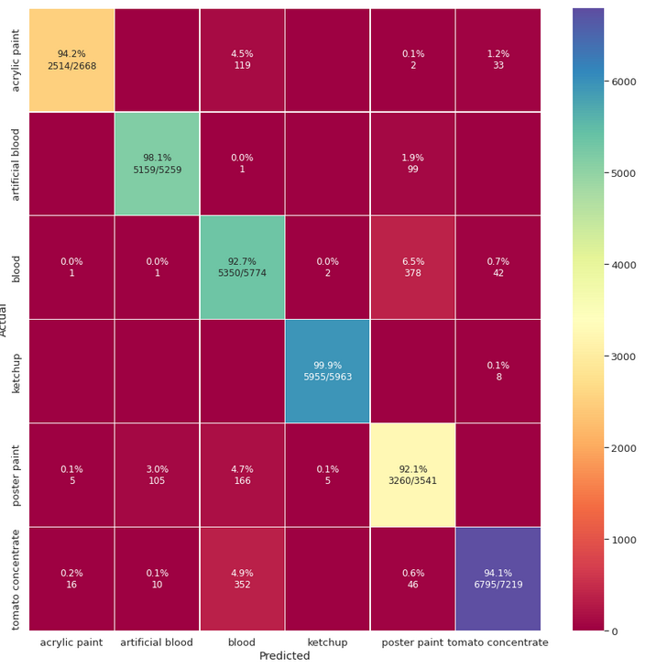
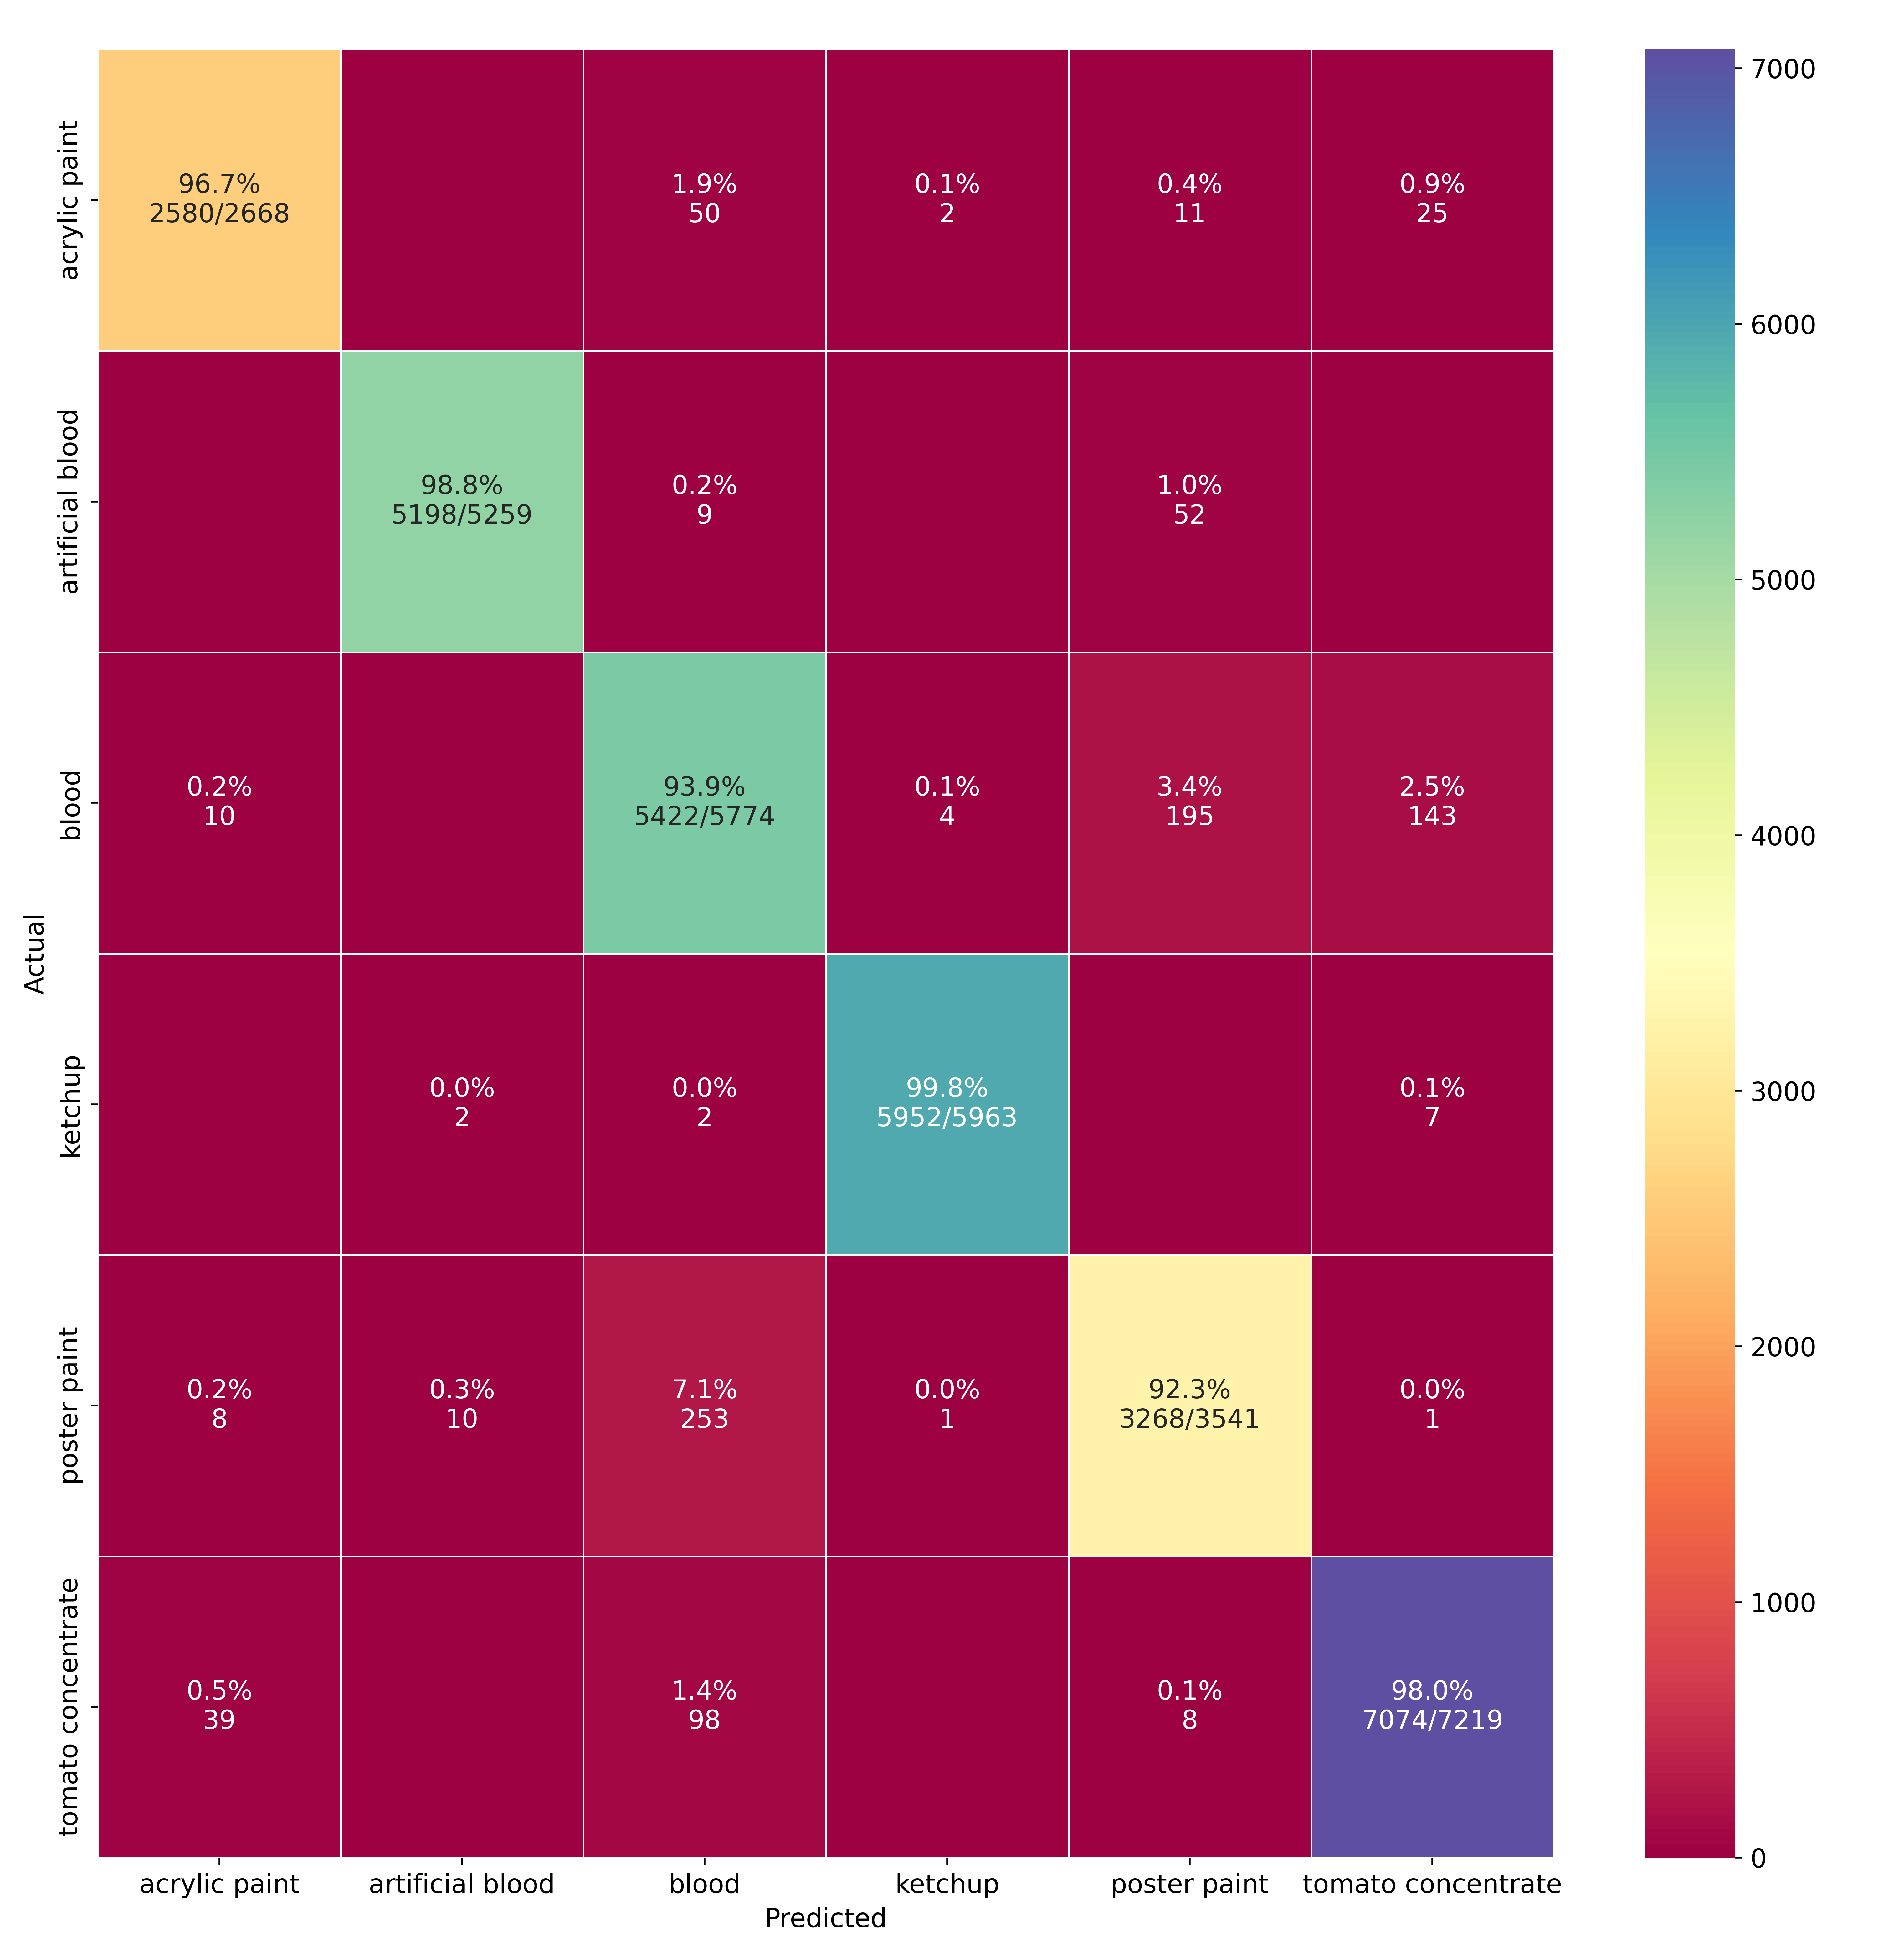
Confusion Matrix
Existing 3D CNN | Proposed 3D CNN

Slide 21
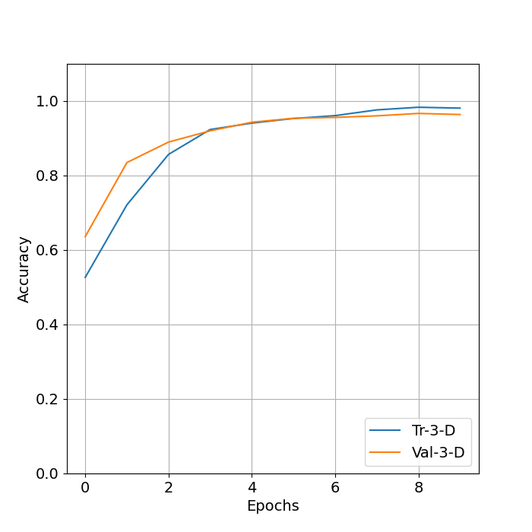
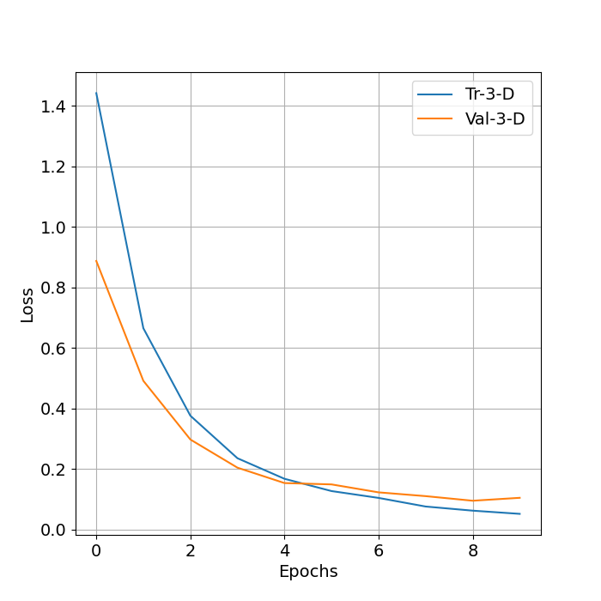
Train Vs Epoch Curve
Figure-4: Accuracy vs Epochs curve
Figure-5: Loss vs Epochs curve

Slide 22
Future Work
Optimize and modify in the convolutional layer
Apply different feature extraction method for better accuracy

Slide 23
Conclusion
The Proposed 3D CNN model gives us 97% accuracy whereas existing model gives 95% accuracy
We can say that if we changes some layer and use Mish activation function instead of ReLU then we get better accuracy .

Slide 24
References
[1] Muhammad Ahmad, Jian Ping Li ,Ramil Kuleev, Muhammad Hassaan Farooq Butt, “A Fast and 3D CNN for Hyperspectral Imaging-based Bloodstain Classification”. Forensic science international, vol. 223, no. 1-3, pp. 28–39, 2022
[2] G. Edelman, E. Gaston, T. Van Leeuwen, P. Cullen, and M. Aalders,“Hyperspectral imaging for non-contact analysis of forensic traces,” Forensic science international, vol. 223, no. 1-3, pp. 28–39, 2021
[3] S. Cadd, B. Li, P. Beveridge, W. T. O’Hare, A. Campbell, and M. Islam, “The non-contact detection and identification of blood stained fingerprints using visible wavelength hyperspectral imaging: Part iieffectiveness on a range of substrates,” Science & Justice, vol. 56, no. 3, pp. 191–200, 2016.
[4] B. Li, P. Beveridge, W. T. O’Hare, and M. Islam, “The application of visible wavelength reflectance hyperspectral imaging for the detection and identification of blood stains,” Science & justice, vol. 54, no. 6, pp. 432–438, 2014.

Slide 25
References
[5] R. Schalike and M. Illes, “A review of spectroscopic methods applied to bloodstain pattern analysis,” Journal of Multidisciplinary Research at Trent, vol. 2, no. 1, pp. 90–104, 2019.

Slide 26
Thank You

